Slide 1
Vital Pathways Hospital Database
Michael Colbert,
Andrew Coffman,
& Shrey Patel
Team 3
Notes:
Shrey: Hi everyone, my name is Dr. Shrey Patel, and I joined by my fellow specialists, Dr. Michael Colbert & Dr. Andrew Coffman
We have a question for y’all….How many of you have visited the hospital for whatever reason? Wait for an answer….Have you ever wondered what kind of system supports that level of coordination??

Slide 2
INTRO
Value of Hospital Management System
78%
70%
56%
Quality of Healthcare
Efficiency of Healthcare
Reduction of costs
**According to a study done by Aykut Uslu & Jurgen Stausberg on the value of Electronic Medical Records for hospital care published between 2010 and 2019.

Slide 3
Agenda
1
3
5
ERD
SATURN
USE CASES
Expl. the Entity Relationship Diagram
Saturn is the ringed one and a gas giant
Showcase the use cases using sample queries
INTRO
RDB
MARS
WRAP-UP
Introducing the Database System
Expl. the Relationship Database Model
Mars is cold and full of iron oxide dust
Conclude with what’s next and Q&A
2
4

Slide 4
INTRO
Vital Pathways Hospital DBMS
Our System:
Purpose:
A database designed to manage hospital operations efficiently
Focuses on patient care, staff coordination, and billing accuracy
Enhance patient care quality
Improve hospital workflow and data integrity
Support decision-making with reliable data
Key Functions:
Benefits:
Tracks patient info, appts, & treatments.
Manages doctor, nurse, and dept. Assignments.
Links treatments to invoices for streamlined billing.
Reduces administrative workload
Ensures compliance with medical data standards
Provides scalable solutions for hospital growth

Slide 5
Who can benefit from this system and why its valuable
Type of Organizations
Hospitals of any size, from small clinics to large medical centers
Specialized healthcare providers (e.g., cardiology, nephrology, urology, physical therapy centers)
Multi-department medical institutions with integrated services
Why is it valuable?
Provides a centralized system for efficient hospital operations
Reduces errors in patient care and billing.
Supports compliance with healthcare regulations and standards.
INTRO

Slide 6
INTRO
Database Usages
Appointment Management
Staff Coordination
Schedule, track, and assign staff to patient appointments
Manage assignments for nurses and doctors for smooth workflows
Find Specialists
Patient History
Find doctors to treat the patient based on their department
Maintain detailed records of treatments, diagnoses, and history
Data Reporting & Analysis
Billing & Invoicing
Generate Insights for decision making ( busiest depts., cost analysis)
Automatically calculate treatment costs & generate invoices for patients

Slide 7
ERD
ERD High Level Overview
PATIENT
DOCTOR
NURSE
Represents the individual attending the appt.
Doctor that is scheduled to see the patient during the appt.
Nurse(s) assisting the patient
TREATMENT
PRIMARY DOC.
INVOICE
Treatment or care provided during the appt.
Patient’s primary physician
Financial record generated for the appt.

Slide 8
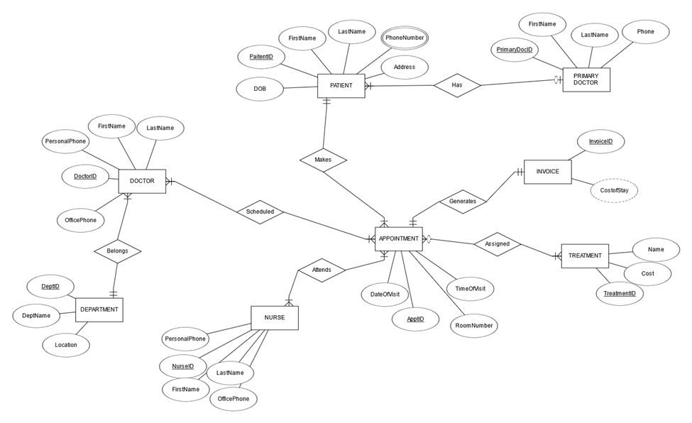
ERD

Slide 9
RDB
RDB Changes
Patient Phones
Invoice Cost
Relations
Invoice
Multivalued Attribute Phone Number and Patient ID are the FK
Calculated Attribute Does not appear in RDB
Attends, Scheduled, Assigned Treatment Many to Many
Invoice is proof of concept for addition of billing

Slide 10
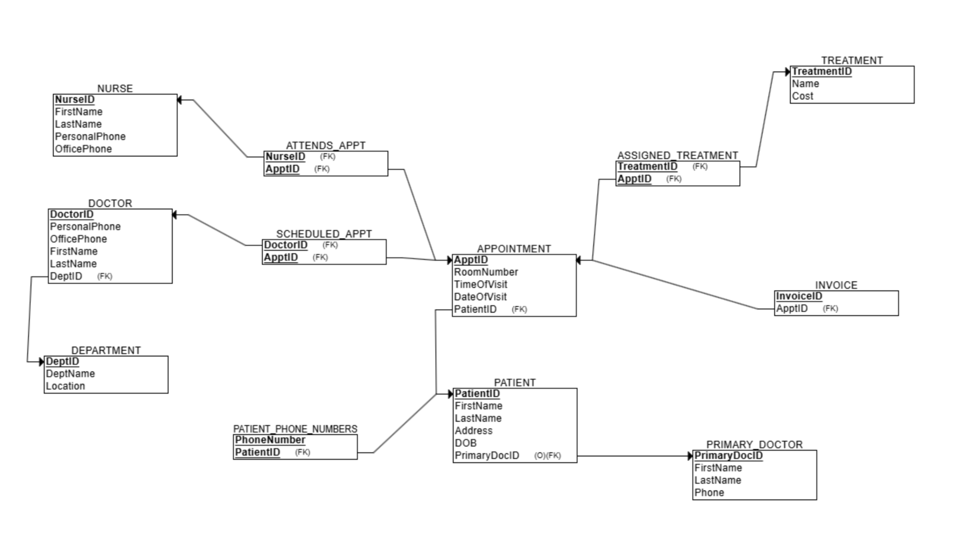
RDB

Slide 11
Use Cases
Index Creation
Treatment Cost
Appointment Room No.
Primary Doctor Phone
Treatment costs will be queried often for invoices, and stay static for long periods of time.
The hospital will often query this information for doctors or nurses, and it will not change unless the patient moves.
Only changes on update of primary doctor phone number. Will be queried when doctors need medical history.

Slide 12
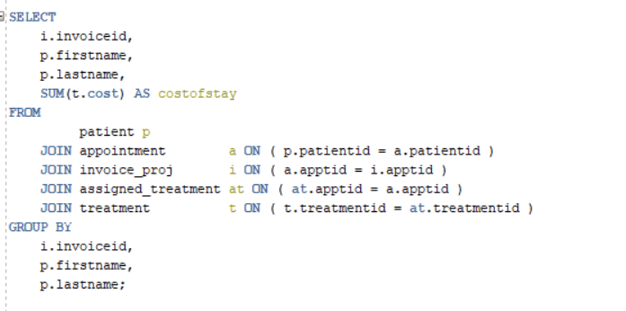
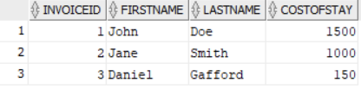
Each Patients Cost of Stay with Invoice
Use Cases

Slide 13
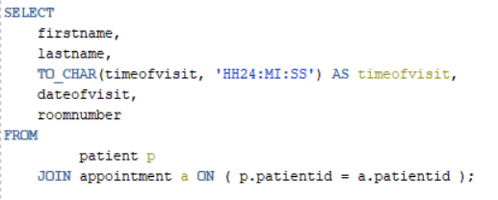
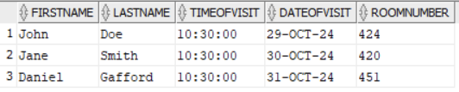
All Scheduled Appointments
Use Cases
QUERY SNAP ON ONE SIDE AND RESULT SNAP ON THE OTHER. The title of the slide should be what we are querying

Slide 14
WRAP-UP
Whats next…
Increasing Patient Records
Integration with New Technologies
The sys. Is designed to handle a growing number of patient profiles as the hospital expands its services or adds new locations.
The database can scale to incorporate IoT devices like wearable health monitors for real-time data collections, and integration with telemedicine platforms
Expansion to Multiple Facilities
Advanced Analytics and AI Integration
The sys. Supports scaling across multiple hospital branches, enabling centralized data management for appts., treatments, and billing across locations.
The platform can integrate with machine learning models or data analytics tools to predict patient trends, optimize resource allocations, and enhance decision-making.

Slide 15
THANK YOU!
Any questions?

